Slide 1
POP goes the Password
By Oktay Sari
October 19, 2022

Slide 3


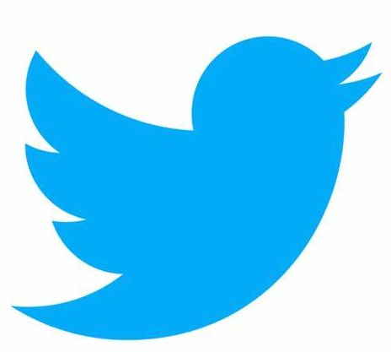
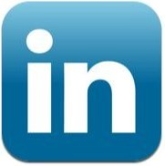
About “Oktay Sari”
Focus
Awards
Microsoft Intune and all things security
From
Hobbies
Netherlands
Hiking, woodworking, RC planes & heli
My Blog
Contact
https://allthingscloud.blog
@oktay_sari
https://www.linkedin.com/in/oktaysari

Slide 4
Agenda
1- Passwordless
Why you should go passwordless
2 - Your Passwordless options
What options do we have
Key takeaways:
3 - Passwordless on Windows from A to Z
What is your excuse for passwords?
Business drivers
How to start
Quiz: Go home with a FIDO2 key
Demo: working passwordless on Windows
4 - Passwordless on mobiles
Demo: No excuse for passwords here.
5 - How to start
How to start your passwordless journey

Slide 5
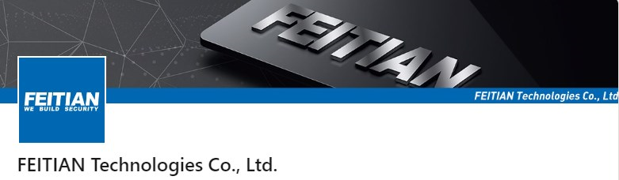

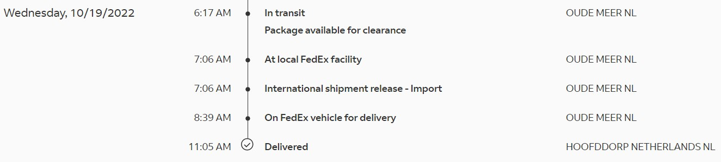

About the Quiz…Thank you!
3x ePass FIDO® NFC – K9 keys!
Chrome OS, Windows, Linux, macOS, Android 5+

Slide 6
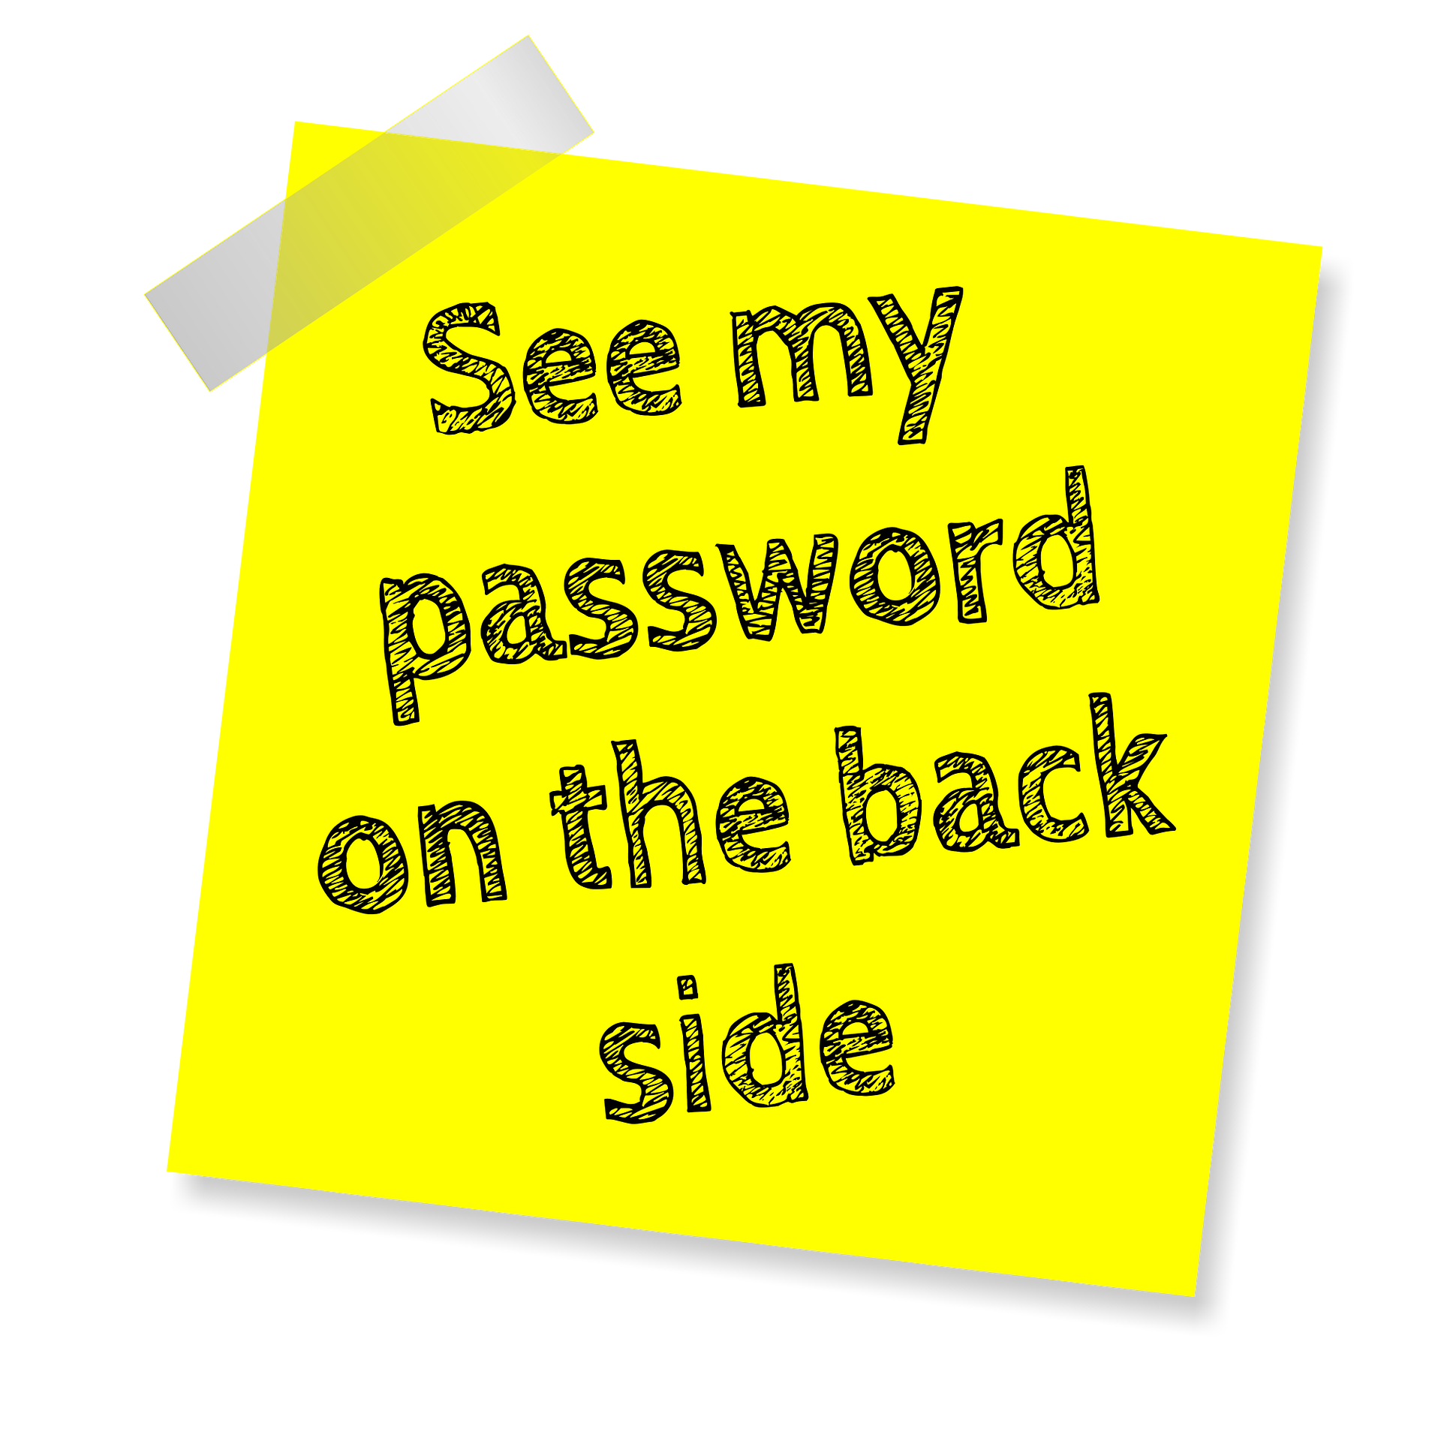
PASSWORDLESS

Slide 7
Passwords…
A little bit of history
The Compatible Time-Sharing System (CTSS), an OS introduced in 1961, was the first computer system to implement password login.
The father of computer password was Fernando J. Corbató

Slide 8

CTSS

Slide 9

The truth about passwords
Why you should go passwordless
Password are:
Hard to remember
Easy to guess

Slide 10
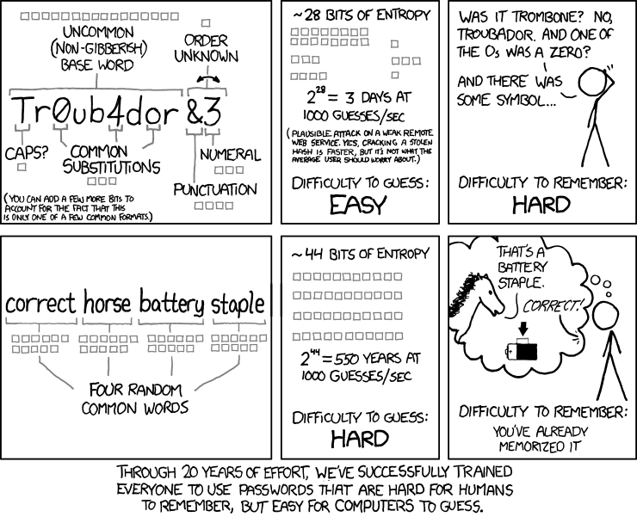
10
Hard to remember, easy to guess
Infographics designed by https://xkcd.com

Slide 11
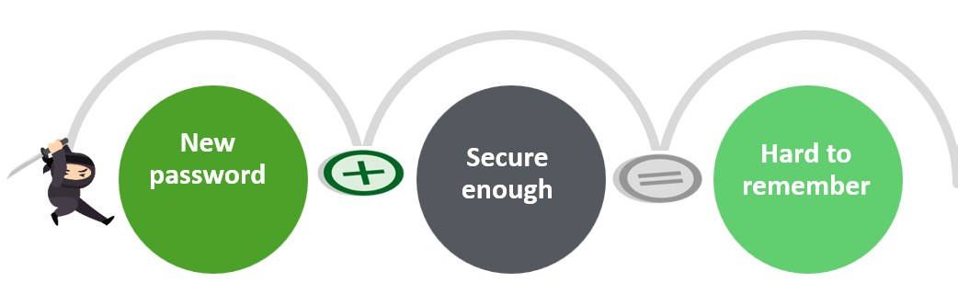
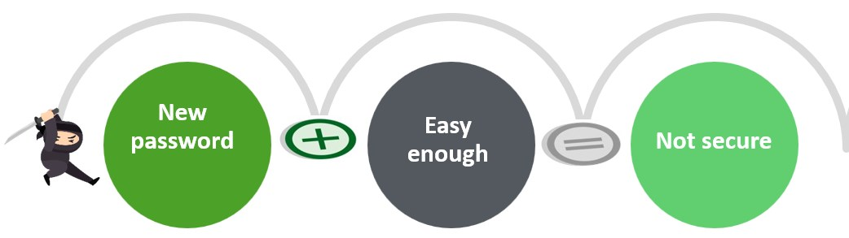

Human nature

Slide 12

Human nature

Slide 13
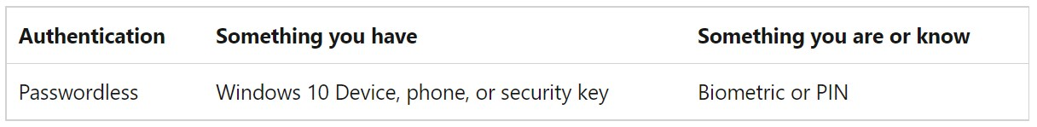
What is Passwordless?
The password is removed and replaced with something you have, plus something you are or something you know.

Slide 14
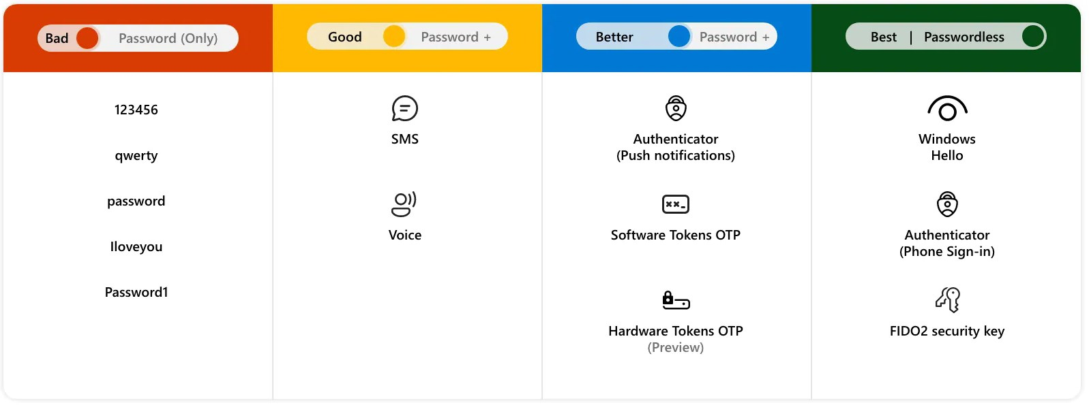
From better to best

Slide 15
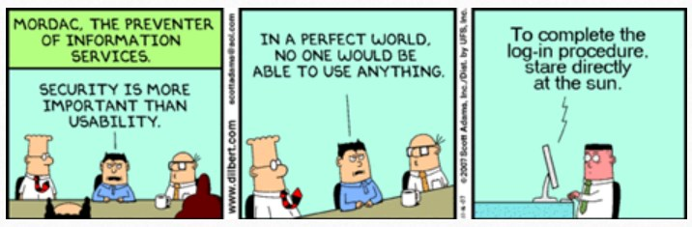
Business drivers
User Experience
Security
Infographic: https://90percentofeverything.com/2009/05/26/dilbert-on-user-experience/index.html
Notes:
A major benefit that comes from getting rid of passwords is user convenience. No longer will users have to deal with complex passwords. This in turn is good for productivity and saves a lot of time.

Slide 16

User experience

Slide 17
Security
38.4
23.000.000
80%
99.9%
Accounts
Easy to guess
Passwords
MFA
The average person has about 38.4 online accounts
still use “123456” as their password
80% of hacking related breaches are tied to passwords
99.9% of accounts get hacked because of this one single reason
Source: SC Magazine, National Cyber Security Centre, Verizon 2020 Data Breach Investigations Report, Windows Central
Notes:
Passwordless authentication will continue to become the norm in the coming year

Slide 18
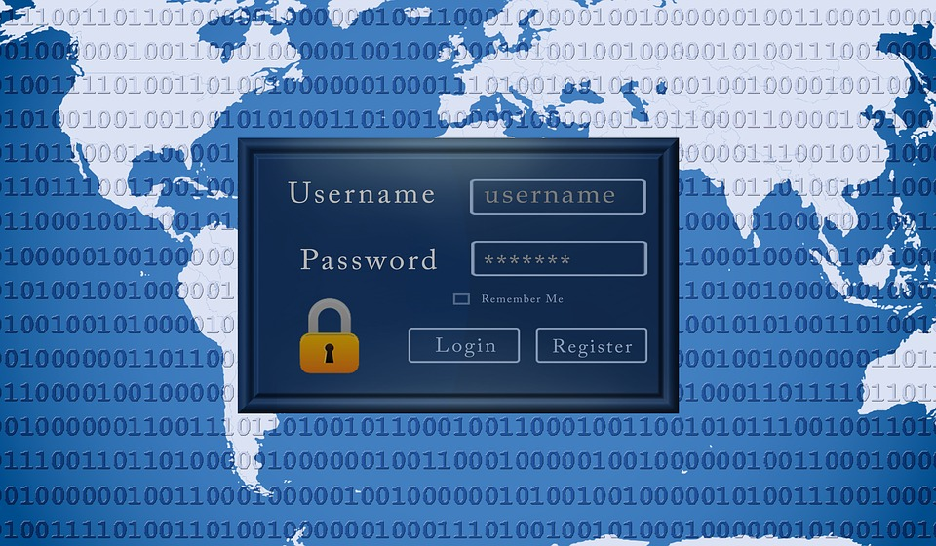
Fun Facts
Did you know that May 5, 2022, was World Password Day? (First Thursday every May)

Slide 19

YOUR PASSWORDLESS OPTIONS

Slide 20
Passwordless options with Azure AD
Windows Hello for Business
Microsoft Authenticator (phone sign-in)
FIDO2 Security keys
Notes:
Passwordless authentication methods are more convenient because the password is removed and replaced with something you have, plus something you are or something you know.
Windows Hello for Business - best for users on their dedicated Windows computers.
Microsoft Authenticator - turns any iOS or Android phone into a strong, passwordless credential by allowing users to sign into any platform or browser.
FIDO2-compliant security keys - useful for users who sign in to shared machines like kiosks, in situations where use of phones is restricted, and for highly privileged identities.

Slide 21
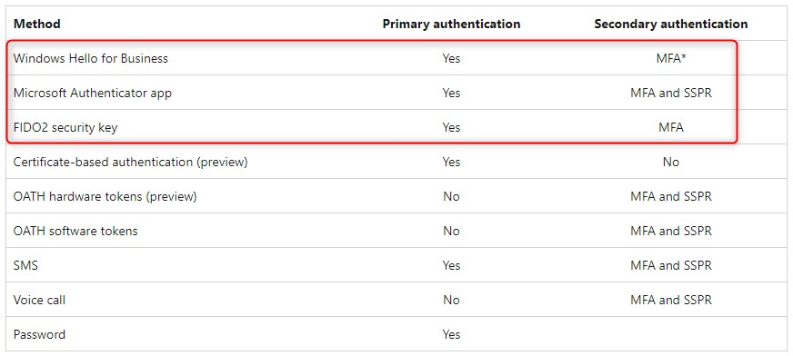
Authentication methods & features

Slide 22
Bootstrap Passwordless methods
Users can bootstrap Passwordless methods in one of two ways:
Existing Azure AD MFA methods
Using a Temporary Access Pass (TAP)

Slide 23
Let’s TAP
Register authentication details during the first sign-in or device setup. (https://aka.ms/mysecurityinfo)

Slide 24
Let’s TAP
Users with a Temporary Access Pass can navigate the setup process on Windows 10 and 11 to perform device join operations and configure Windows Hello For Business

Slide 25
Quiz
The father of computer password was…

Slide 26

DEMO: Passwordless on Windows

Slide 27
Let’s (en)roll
Windows enrollment using TAP
Configure Windows Hello for Business
Configure a FIDO2 Security key
Passwordless Sign-in

Slide 28
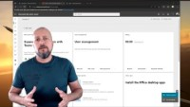
DEMO: Passwordless on Windows
To watch the demo video, click on the link below. This video will have audio and extra information. https://youtu.be/zXxOIhspc_c

Slide 29
FIDO2 configuration
Let’s configure a FIDO2 security key

Slide 30
Quiz
What date is world password day in 2023

Slide 31

DEMO: Passwordless on Mobiles

Slide 32
Let’s (en)roll
Configure the Authenticator App
Setup phone Sign-in
Configure Outlook (MAM only)
Configure a work profile
Company Portal App
Sign-in from another device

Slide 33
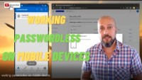
DEMO: Passwordless on Mobiles
To watch the demo video, click on the link below. This video will have audio and extra information. https://youtu.be/UXdZS3c_cVk

Slide 34

Let’s wrap up

Slide 35
The Pros
Duh…No password!
Improves user experience
a brute-force attack is less likely to be successful
Bye Bye Password Spraying. Not one password is the same!
Credential stuffing / Phishing is out!
Windows Hello to sign-in on Windows device
Stronger Cyber Security Posture
Security key with biometrics for better experience
Reduced Long-Term Costs
I ask again… What is your excuse for passwords?

Slide 36
The Cons
Loss or theft of security keys
(then again, people forget their passwords too)
SIM swapping if you’re using phone sign-in
Biometrics are not bulletproof
Doesn’t protect against some malware
Man-in-the-browser attacks are still possible
End-User skepticism
Deployment Cost and Effort?
Think about fallback scenario

Slide 37
Quiz
The average person has about … online accounts.

Slide 38
How to start
Research
Test
PILOT
Start slow and evaluate
Transition into passwordless deployment

Slide 39
Microsoft's Strategy
Develop password-replacement offerings
Reduce user-visible password surface area
Eliminate passwords from the identity directory
Transition into a password-less deployment
YOUR TURN!

Slide 40
Resources
Plan a passwordless authentication deployment in Azure Active Directory - Microsoft Entra | Microsoft Learn
SMS-based user sign-in for Azure Active Directory - Microsoft Entra | Microsoft Learn
Overview of Azure AD certificate-based authentication - Azure Active Directory - Microsoft Entra | Microsoft Learn
Password-less strategy - Windows security | Microsoft Learn
You searched for passwordless - All Things Cloud - Azure - EMS -Intune - Office 365 – Security
Announcing public preview of SSO and passwordless authentication for Azure Virtual Desktop - Microsoft Community Hub
Authentication methods and features - Azure Active Directory - Microsoft Entra | Microsoft Learn

